Slide 1
Peaker Services Inc. Turbine Controls
Maintaining safe and secure power at critical sites
peaker services, inc.

Slide 2
In 2019, the power plant for the world renown Mayo Clinic Hospital in Rochester, MN needed to upgrade their outdated controls. They turned to Peaker Services, Inc. for the system integration of the state of the art Woodward Turbine Controls

Slide 3
System Integration Activity
Procure, design, fabricate and test control panels;
Procure, design, and fabricate interfaces (mechanical and hydraulic) for Woodward Varistroke steam valve rack actuation and control;
Procure, design, fabricate instrumentation interfaces;
Create electrical field wiring diagrams;
Install, configure, commission and test all systems;
Provide operating and maintenance staff training;
Final O&M documentation package.

Slide 4
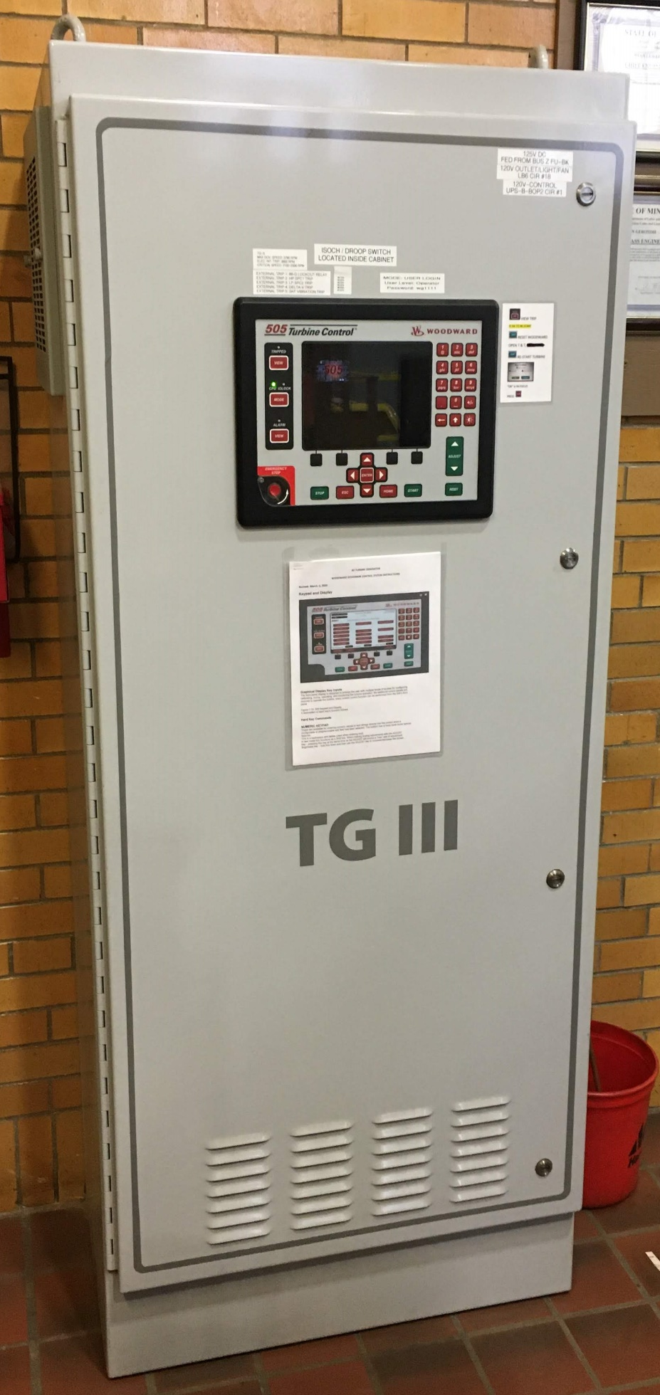
Steam turbine controls were updated with the industry premier steam turbine control: The Woodward 505XT
Woodward 505XT
TG#3 installed and commissioned in 2019
TG#1 and TG#2 partially installed in 2019 – installation and commissioning completed in 2020
TG #1 and #2
(Turbine Generator)
TG #3
(Turbine Generator)

Slide 5
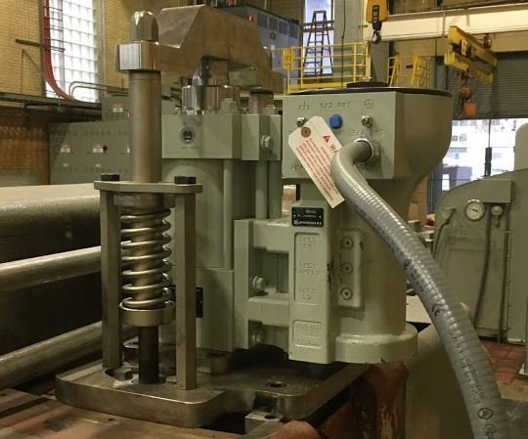
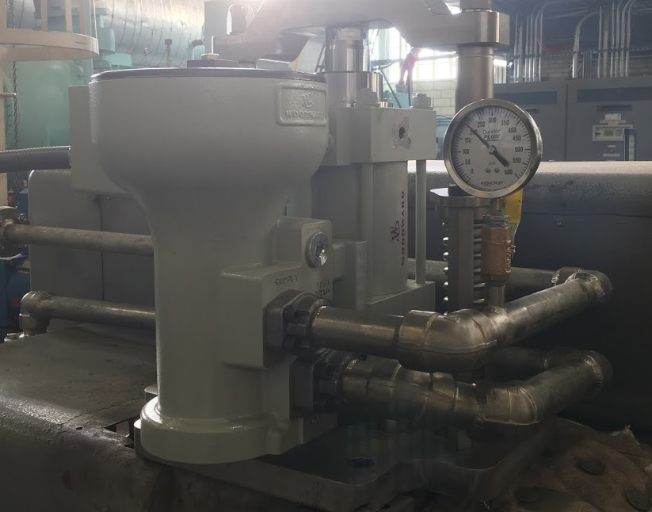
Turbines were updated with superb accuracy and resolution: The Woodward VaristrokeTM Actuator

Slide 6
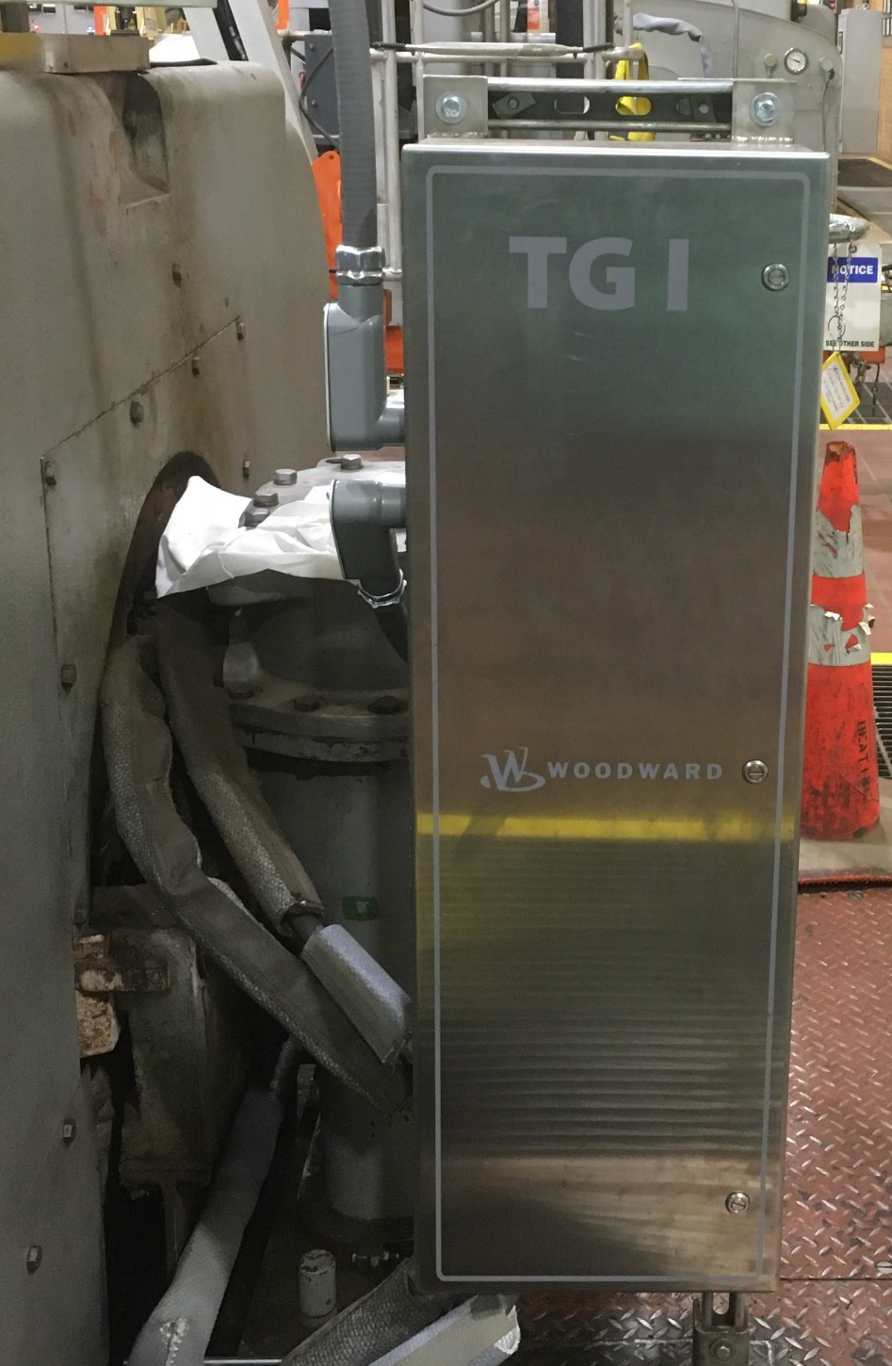
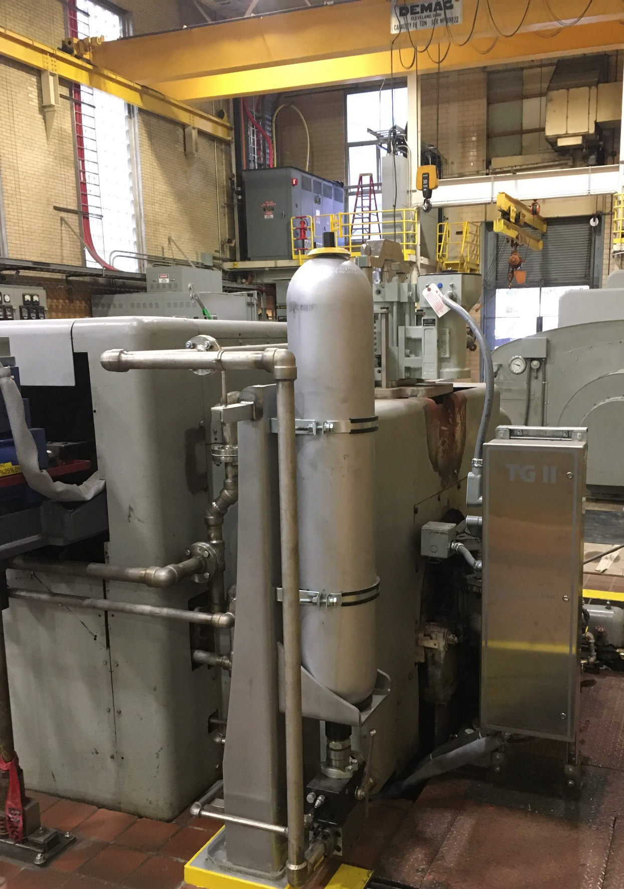
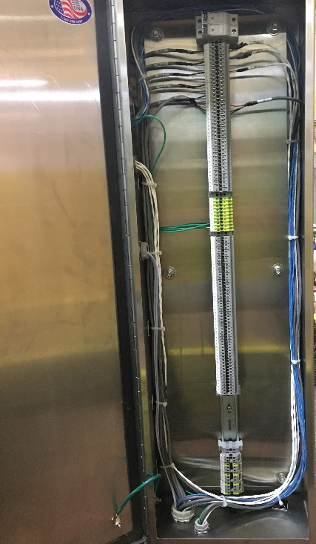
Various junction boxes and cabinets were installed to protect wiring and provide easy access

Slide 7
Status of the Mayo Clinic Franklin Heating Station Main Office
Even though the plant produces electricity, their primary goal is to provide 10 psi of steam to the hospital. The continuous supply of 10 psi steam is critical to the heating and sterilization processes of the hospital. The 10 psi steam header is fed from three sources - the exhaust of TG#3, the extraction steam from TG#1, and the extraction steam from TG#2. The 10 psi header pressure is controlled by a complex cascade PID loop programed by Peaker Services into the Woodward 505XT.
Final Result:
At the Mayo Clinic Hospital, this heating/disinfecting steam is critical. Since the commissioning of all three turbines, the hospital has enjoyed power generation, and a continuous supply of well maintained 10 psi steam.

Slide 8
Powering the Mayo Clinic
“With a focus on caring for patients with serious, complex illnesses, Mayo Clinic operates in five states and cares for more than one million people a year, from all 50 states and nearly 140 countries.”
The Mayo Clinic in Franklin, MN continues to operate with reliable power and heat, controlled with PSI installed Woodward Controls

